Slide 1
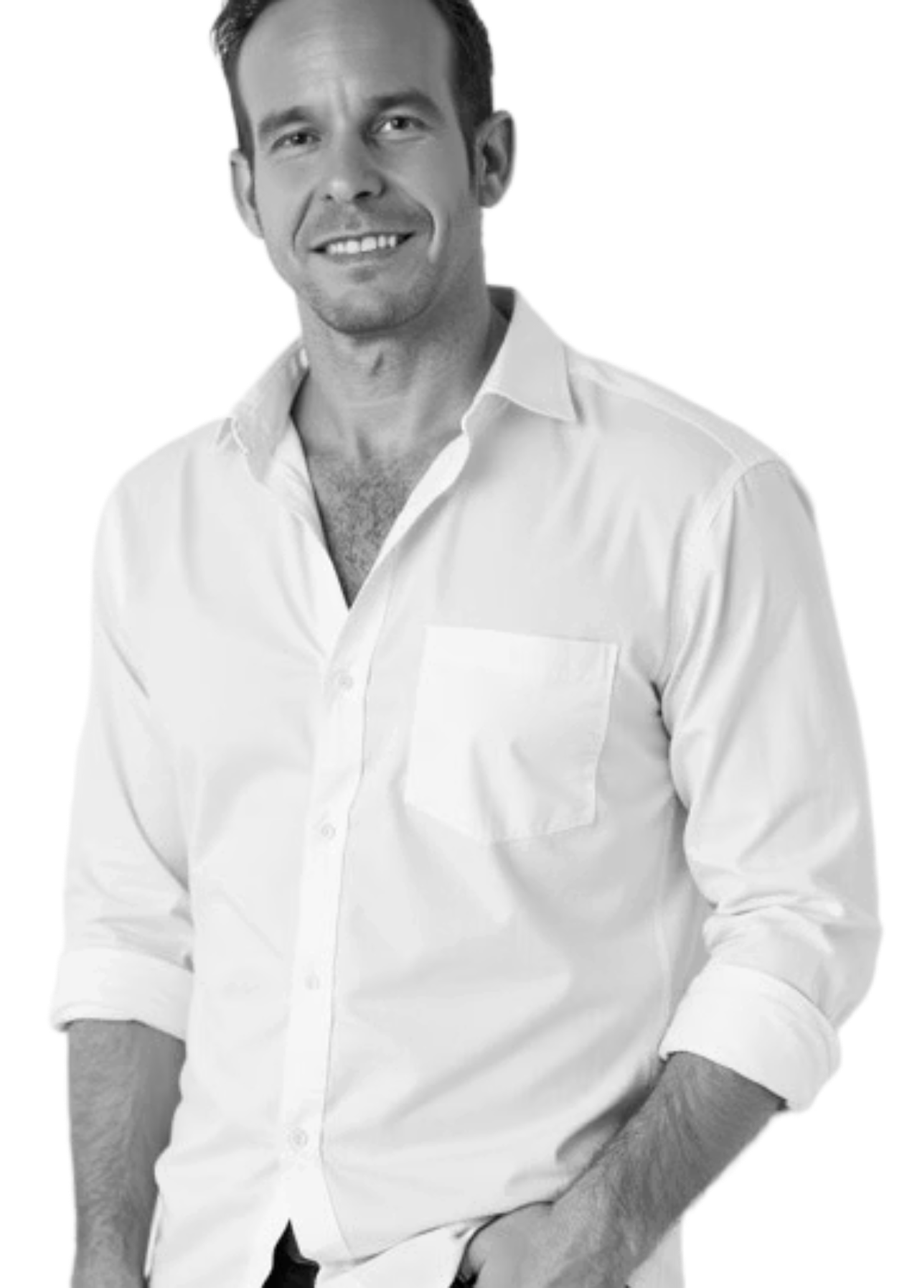


Media Kit
Testimonials
"Dr. Joseph Ryan Smolarz's story is transformational—proof that intentional mindset shifts can create massive impact. From accomplished board-certified surgeon to strategic investor and thought leader, he exemplifies the power of purposeful growth and reinvention. His LIFTOFFNOW Framework—especially the shift from consumer to investor—is revolutionary.“
Felix Okoth, PMP®, Keynote Speaker, Author, Executive Leadership Coach
Dr. Joseph Ryan Smolarz, M.D., M.B.A.
Surgeon | Investor | Speaker
Joseph Ryan Smolarz, MD, MBA is a surgeon-turned entrepreneur, investor, and thought leader in healthcare, real estate, and innovation. As the founder of Beehive Homes Assisted Living of Broken Arrow, Smell Again, Dr. Ryan's and STOR Partners, he also serves as the blockchain lead for SToR Token. With multiple patents and over $30 million in assets under management, Dr. Smolarz blends medical expertise with business acumen to drive impact across industries. A former chief resident at the world's busiest trauma center, he now teaches doctors how to reclaim their time through investing.
Dr. Smolarz is the author of the upcoming book "Heal Thy Wallet" and hosts the Medicine and Money Show. As a sought-after speaker and advisor, he has been featured in Forbes, Yahoo Finance, and Marquis Who's Who.
"Ryan Smolarz was a knowledgeable guest on the Awakened Titans Podcast, where he spoke about Financial Freedom For Doctors. His clear, practical advice and deep understanding of both medicine and money made this episode a must-listen for healthcare professionals.“
Lily Patrascu, book publisher - www.lily.global
"I've known Dr. Ryan Smolarz personally for several years, and we've shared conversations at investment gatherings from Las Vegas to Tampa. Beyond being a trusted friend, Ryan has always impressed me with his disciplined approach, intellectual curiosity, and sharp eye for opportunity."
Des Woodruff, AI & Machine Learning Strategist |
Quantitative Fund Manager

Slide 2

Media Reach
Email List: 14K+
Social Media: 35K+ Reach
Featured on Forbes, Yahoo Finance, and Marquis Who's Who
Professional Statistics
68K+ hours worked in hospitals
10K+ surgeries performed
150K+ patients under his care
30 million+ in assets under management
6 Patents published with one patented product on the market
Speaking & Podcast Topics
Why is the LIFTOFFNOW system different than other methods?
How does learning to invest help patients?
Should I care about psychology in investing?
Do I need to understand markets?
The Medicine
and
Money Show
This show is for doctors, investors, entrepreneurs, and anyone seeking to combine the power of medicine and money. You'll learn proven strategies and tactics to maximize your wealth and influence by understanding the intersection of healthcare and investing. Each episode is hosted by Joseph Ryan Smolarz, a leading figure in healthcare entrepreneurship, and his team, as they share expert insights and practical advice on navigating both fields.
Contact Information
FOR SPEAKING/PODCAST
REQUESTS:
rsmolarz@medmoney.com
FOR INVESTMENT INQUIRIES:
info@storpartners.com
FOR ALL GENERAL INQUIRIES:
rsmolarz@rsmolarz.com
"Money doesn't buy happiness, but it sure does
make a lot of problems go away."
J. Ryan Smolarz, M.D., M.B.A
Tech Info: Ryan will do his best to be stationary for this interview in his home studio prepared with front lighting, live video, audio headset, high quality microphone and sound equipment. But he has an intense travel schedule and sometimes has to do interviews from the road or his hotel room. Please let him know if you have any special requirements.
"I hope to have the opportunity to meet you and provide value to your community."

